Slide 1
Displaying Large Organizational Networks
Steve Scheinert
Springboard Data Science Career Track
Capstone Project 1

Slide 2
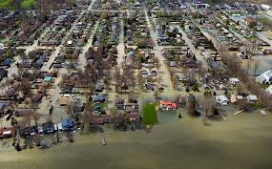
Preserving Lake Champlain
In light of Climate Change
In light of human decisions about:
Policies
Land use decisions
Demographic and economic shifts

Slide 3

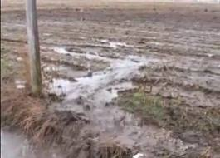
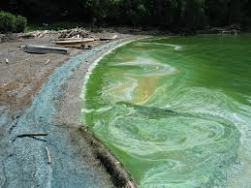
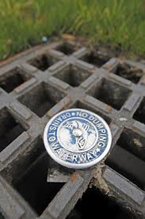
Algae blooms and phosphorus loading…
Our particular point of concern in RACC is coming to a better understanding of the hydrological and human dynamics contributing to this situation.

Slide 4
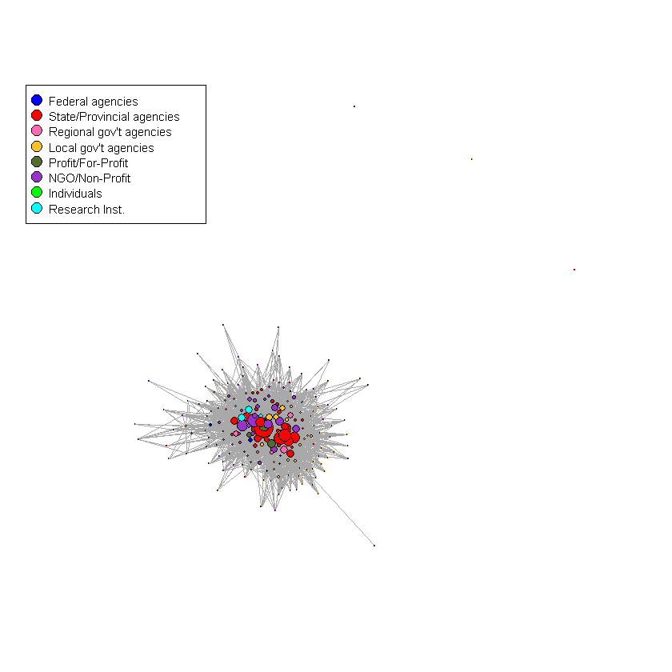
The Problem: A Communications Tool that Doesn’t Communicate
Information Sharing network in Vermont’s portion of the Lake Champlain Basin about Water Quality Management

Slide 5
Why so complex: Structure of Watershed Governance in the Lake Champlain Basin
Notes:
But even this figure is relatively neat and tidy compared to the real activity that’s going on.

Slide 6
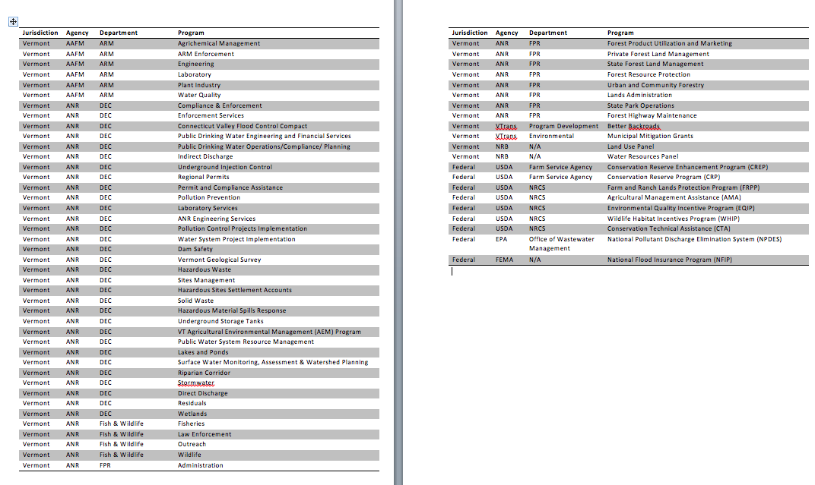
Why so complex: All the places where money for water quality mitigation come from
60 + FEDERAL AND STATE PROGRAMS
Notes:
Accountability links direct and manage money in the network. The behaviors that accountability direct can be viewed through how organizations spend their money. This money enters the system from many different sources, seeking many different goals. The conceptual models tell us this. The network models allow us to get specific about how that money can move through the system. With a network structure, we have a structure for detailed financial flows. We have an image here of that structure in water quality management in the Lake Champlain Basin, but such a network could be constructed in any policy issue.

Slide 7
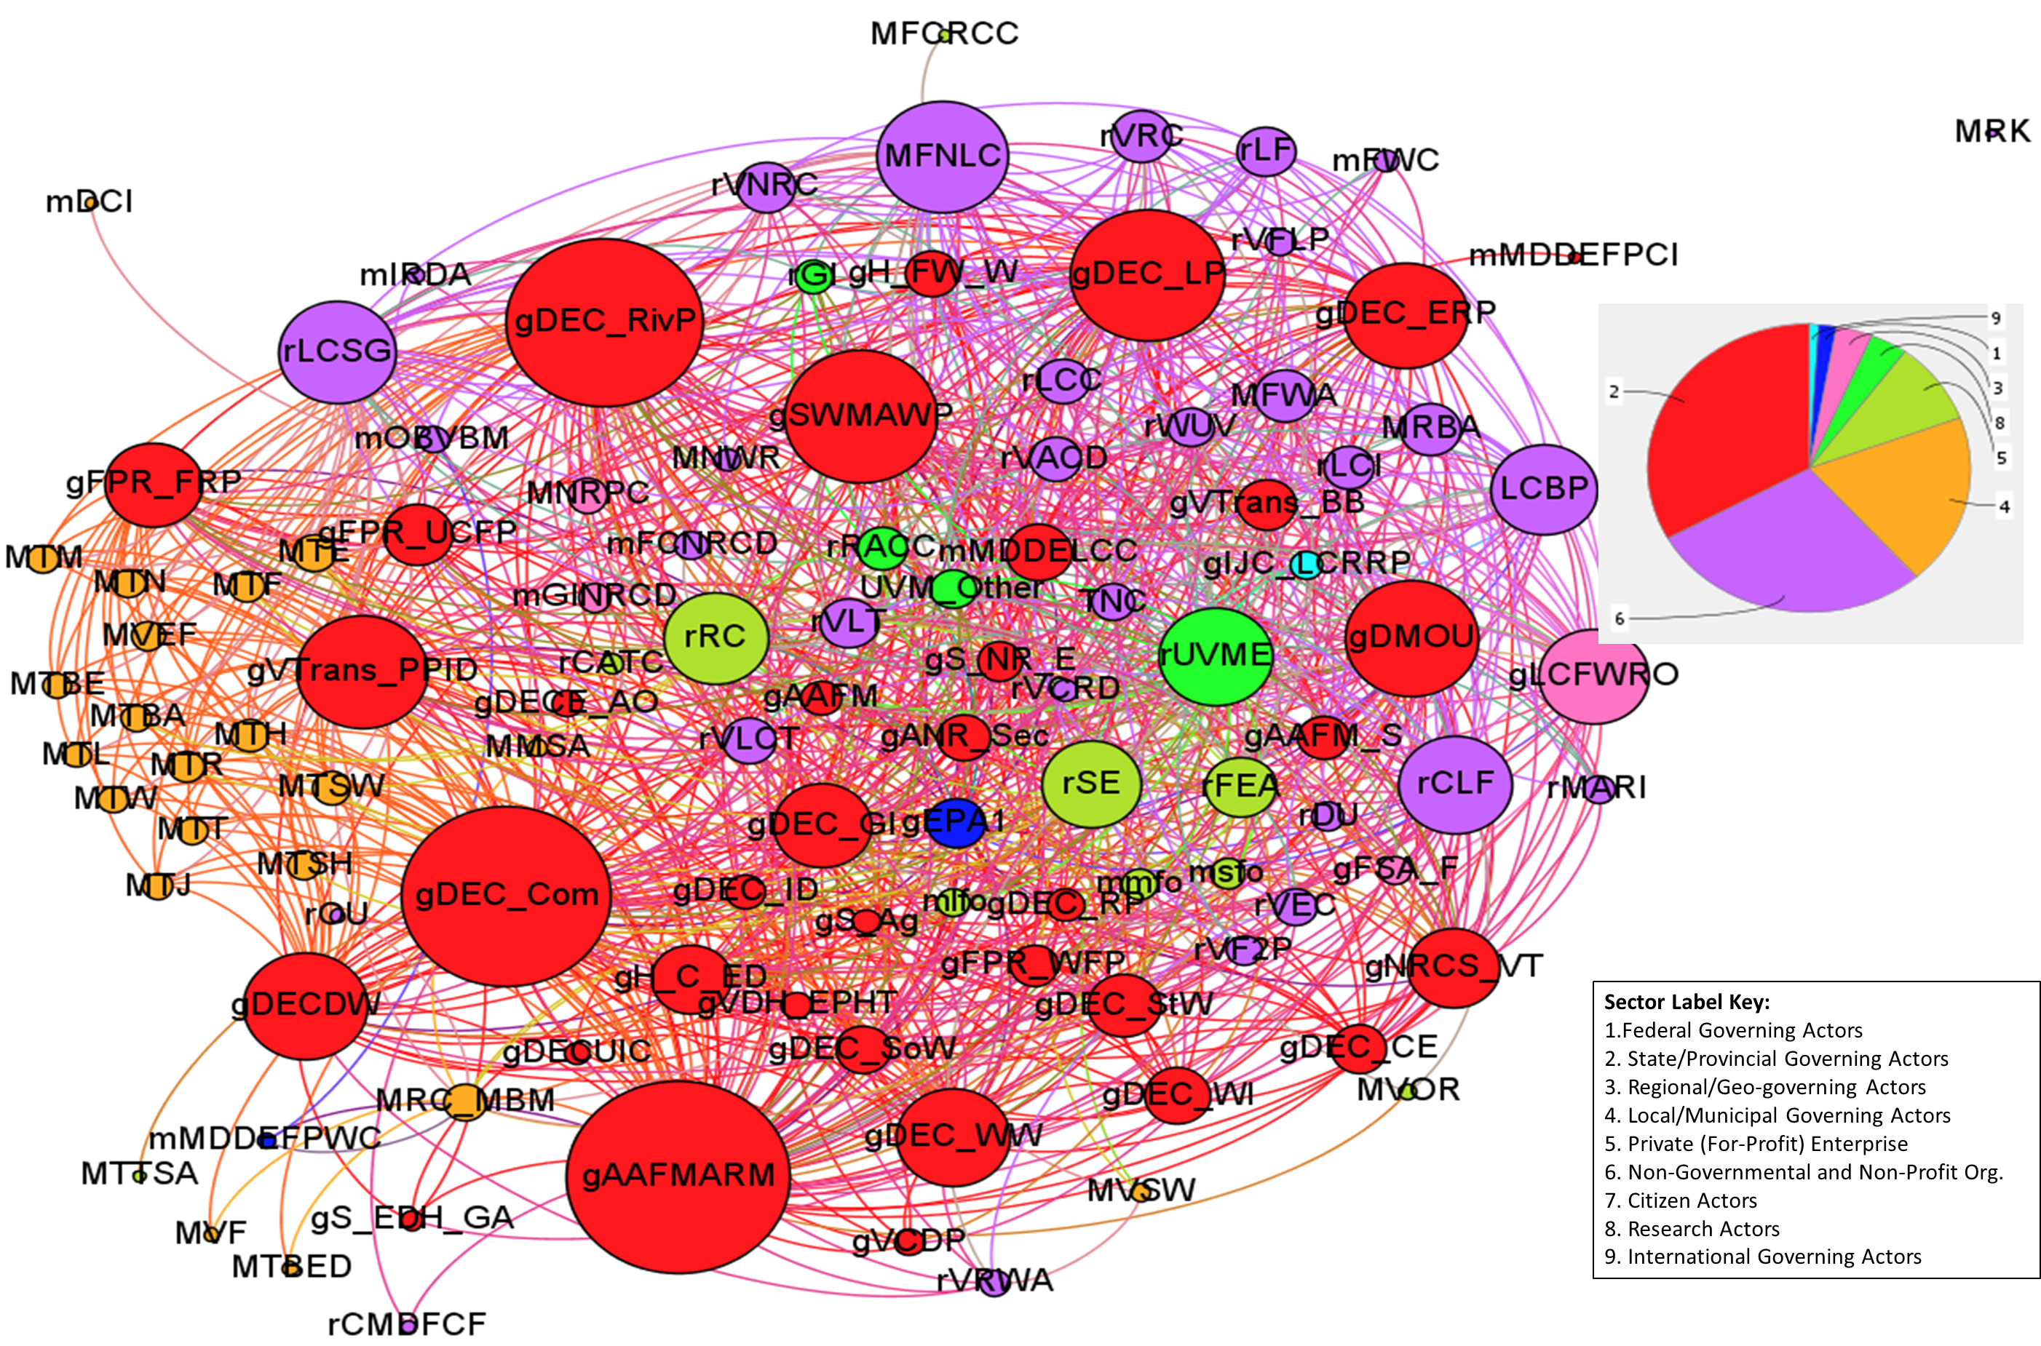
A Closer Look but still Complex: 2014 Water Quality Network for Missisquoi Watershed
Key Nodes:
gAAFMARM: Ag. Resource Mgmt. Program (VT AAFM)
gDMOU: Data Sharing MOU (VT AAFM)
gDEC_Com: Office of the Commissioner, VT DEC
gDEC_RivP: Rivers Program, VT DEC
gSWMAWP: Watershed Planning, VT DEC
gVTrans_PPID: VTrans Policy Planning
rLCSG: Lake Champlain Sea Grant
LCBP: Lake Champlain Basin Program
rCLF: Conversation Law Foundation
MFNLC: Friends of Northern Lake Champlain
rUVME: Extension Services, Univ. of Vermont
rRC: Redstart Consulting
rSE: Stone Environmental
(Scheinert et al., 2014; Generated in Gephi)
Notes:
This is just a slice of the whole network. We can quickly see how dense and how complex the pattern of interactions are. But we still need to make and implement policy through this network, and assess how that all went.

Slide 8
The Solution: An interactive network display tool
https://wmirecon.shinyapps.io/vgn-v5_10oct17/
(Presentation would shift to a live demonstration of the app)

